Slide 1


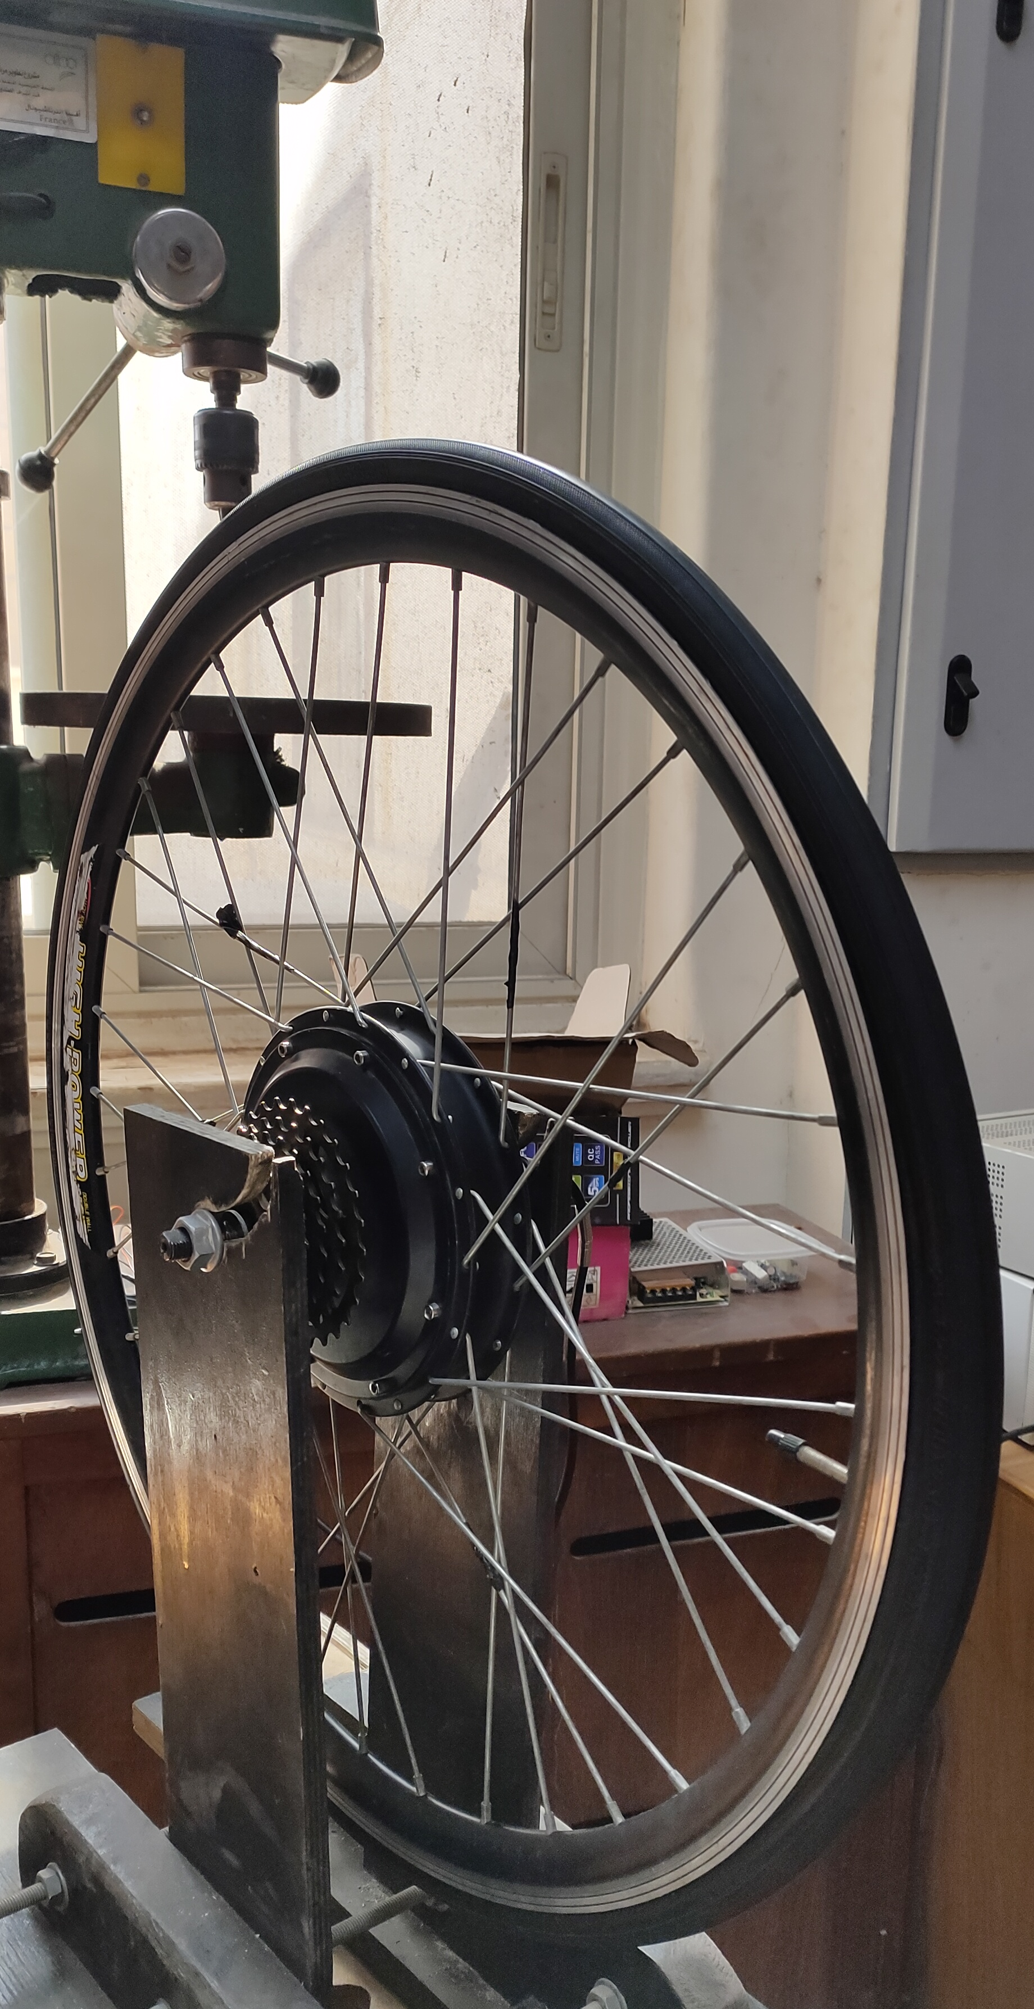
Prototype
Electric
Vehicle
Cairo University
Faculty of engineering
Electrical Power Engineering Department.
Graduation Project (EPM480)
Dr. Ahmed Lotfi
Supervised By:

Slide 2






Our Team
Abd-Elrahman
Elsayed
Ehab
Ashraf
Ali
Emad
Awab
Anwar
Mohamed
Ragab
Ezz-Eldien
Magdi

Slide 3

System Block Diagram
DC Source
PWM generator
PWM
Inverter
Reference Speed
Duty Cycle
BLDC
Error
PI controller
PWM
+
_
PWM
Actual Speed
Commutation Sequence
Hall Sensors
Speed calculation
Hall sensor decoder

Slide 4
BLDC Motor
Specs & Model

Slide 5
Inverter Design
Power ct - MOSFET & Diodes selection
Control ct
Gate driver
Boot strap
Gate resistance & diode
PCB design

Slide 6
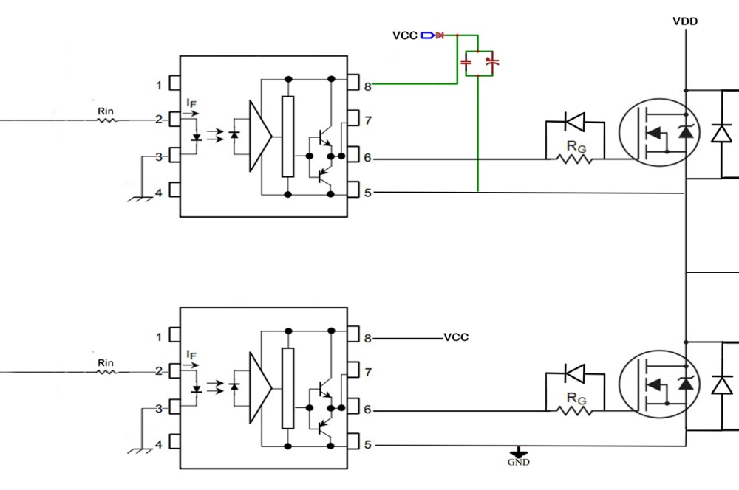
Inverter Design
Bootstrap circuit
Gate Resistance & Diode
Gate Drive
MOSFET
FWD

Slide 7
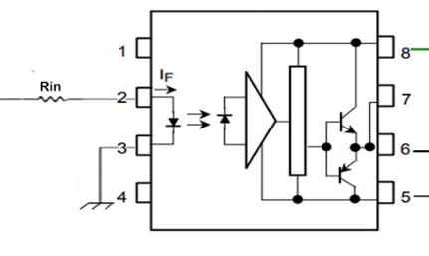
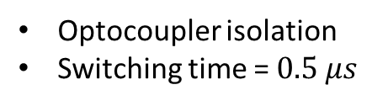
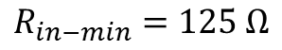
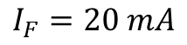
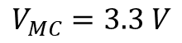
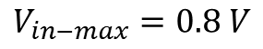
1
Gate Drive
Optocoupler isolation
Switching time = $0.5 μs$
$$V_{in−max}=0.8 V$$
$$V_{MC}=3.3 V$$
$$I_{F}=20 mA$$
$$R_{in−min}=125 Ω$$

Slide 8
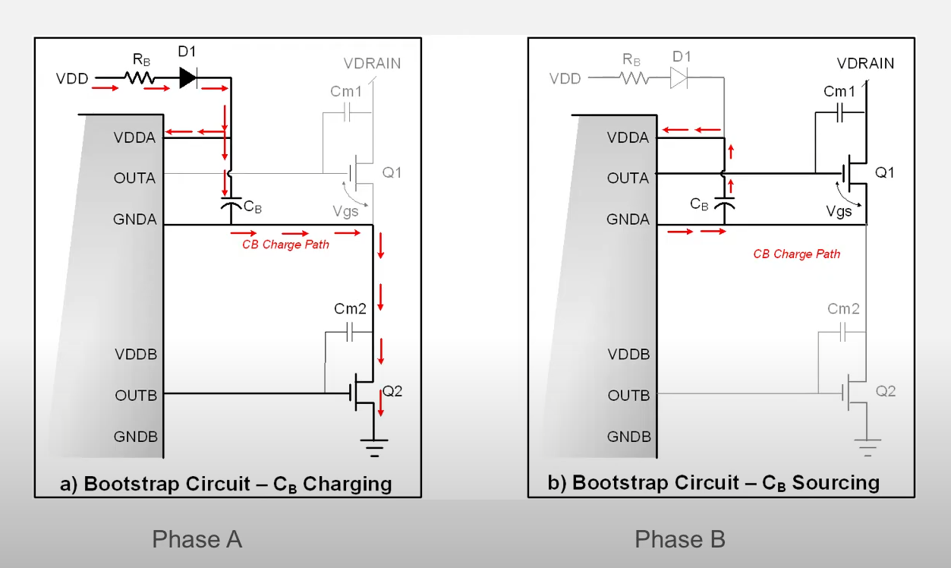
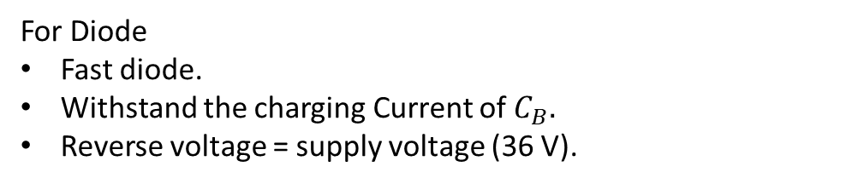
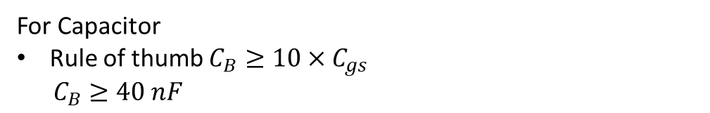
2
Bootstrap Circuit
Enable using only one supply for all gate drives.
Isolated supply for high-side MOSFETs.
For Capacitor
Rule of thumb $C_{B}≥10×C_{gs}$
$C_{B}≥40 nF$
For Diode
Fast diode.
Withstand the charging Current of$C_{B}.$
Reverse voltage = supply voltage (36 V).

Slide 9
Open loop system
DC Source
Decoder
PWM generator
Performance
Waveforms
PWM generator
PWM
Inverter
Duty Cycle
BLDC
PWM
PWM
Commutation Sequence
Hall Sensors
Hall sensor decoder

Slide 10
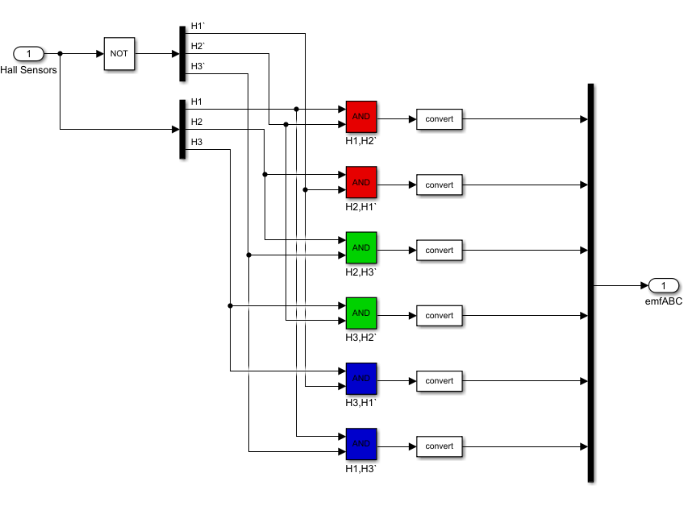
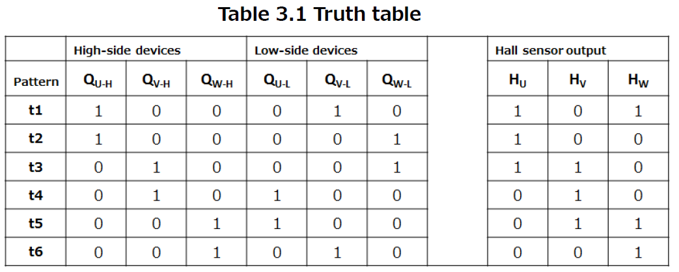
1
Decoder
Commutation Sequence
Hall Sensors
Hall sensor decoder

Slide 11
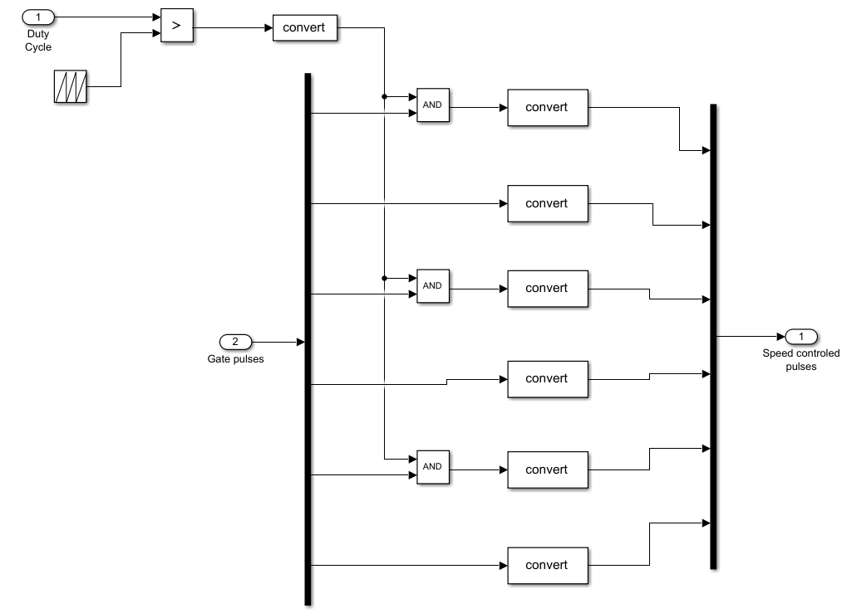
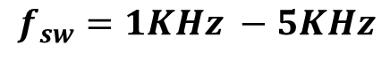
2
PWM Generator
PWM generator
PWM
In Microcontroller
PWM mode is center aligned.
Less harmonics due to symmetry
Duty Cycle
PWM
$$f_{sw}=1KHz −5KHz$$
PWM
Commutation Sequence

Slide 12
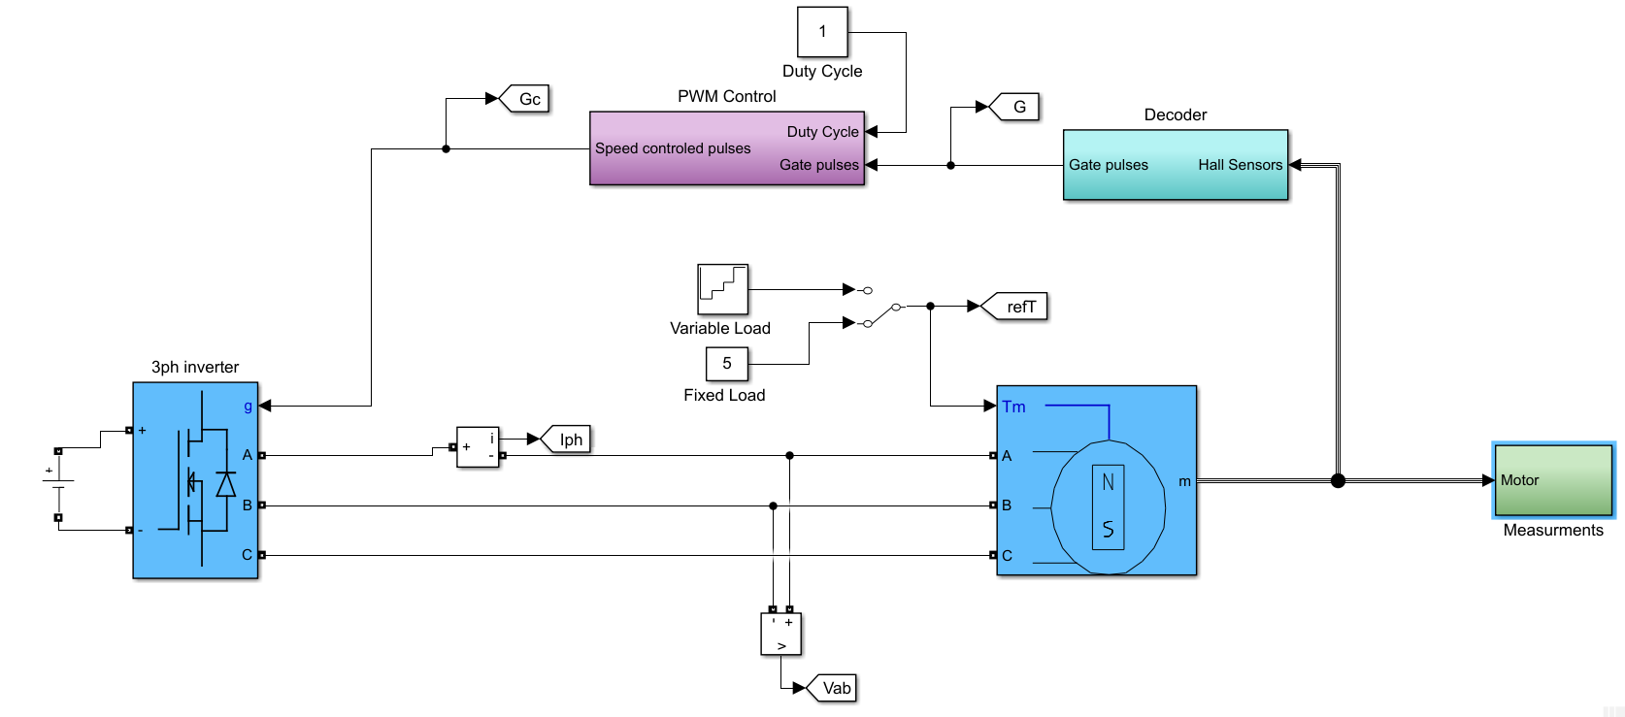
3
Speed Performance

Slide 13
Closed loop system
DC Source
PWM generator
PWM
Inverter
Reference Speed
Duty Cycle
BLDC
Error
PI controller
PWM
PWM
Actual Speed
Commutation Sequence
Hall Sensors
Speed calculation
Hall sensor decoder

Slide 14
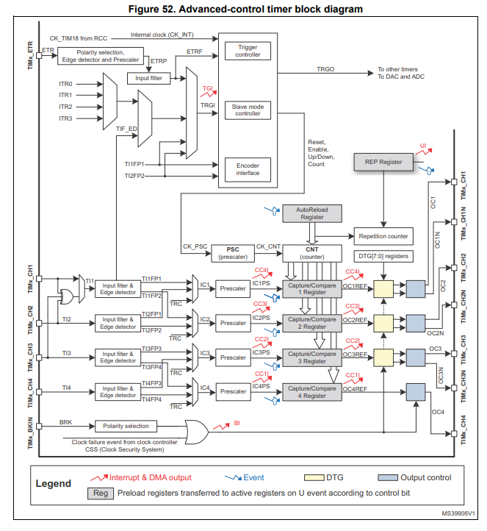
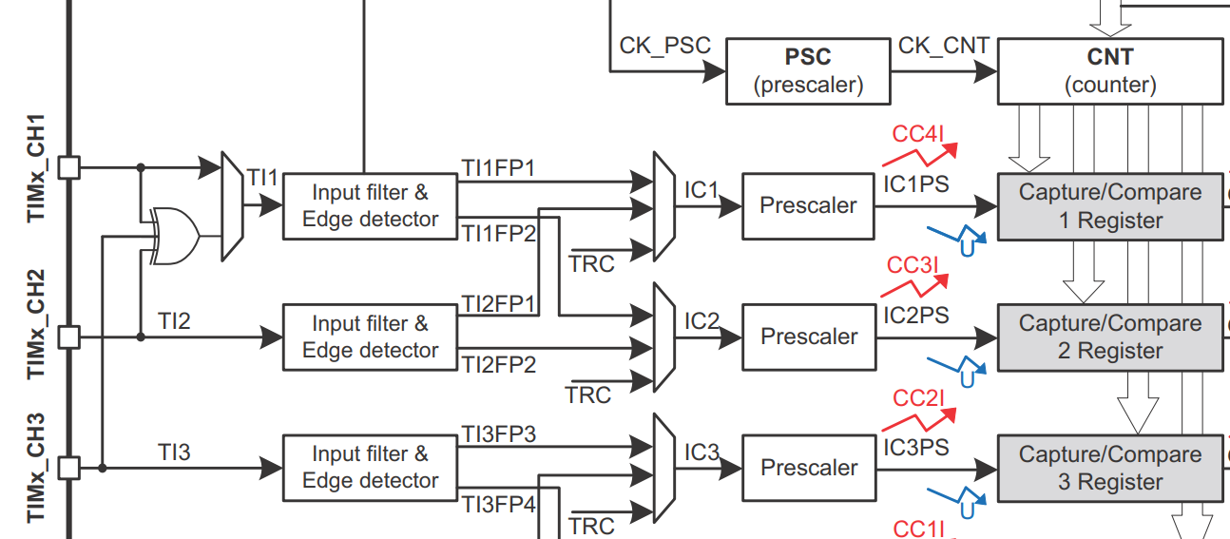
1
Speed calculation

Slide 15
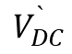
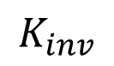
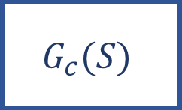

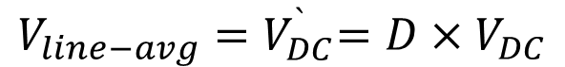
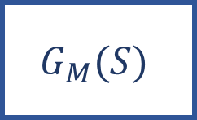
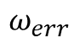
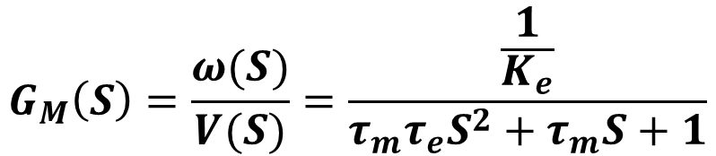
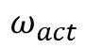

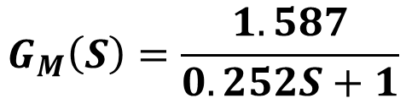
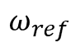

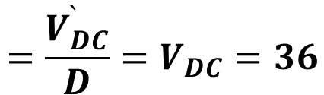
2
PI controller design
??
$$ω_{ref}$$
$$ω_{err}$$
$$G_{c}(S)$$
$$D$$
Inverter
$$V_{DC}^{`}$$
$$G_{M}(S)$$
$$ω_{act}$$
$$+$$
$$−$$
$$G_{M}\left(S\right)=\frac{ω(S)}{V(S)}=\frac{\frac{1}{K_{e}}}{τ_{m}τ_{e}S^{2}+τ_{m}S+1}$$
$$V_{line−avg}{=V}_{DC}^{`}=D×V_{DC}$$
$$=\frac{V_{DC}^{`}}{D}=V_{DC}=36$$
$$G_{M}\left(S\right)=\frac{1.587}{0.252S+1}$$
$$K_{inv}$$
One Pole at -4

Slide 16
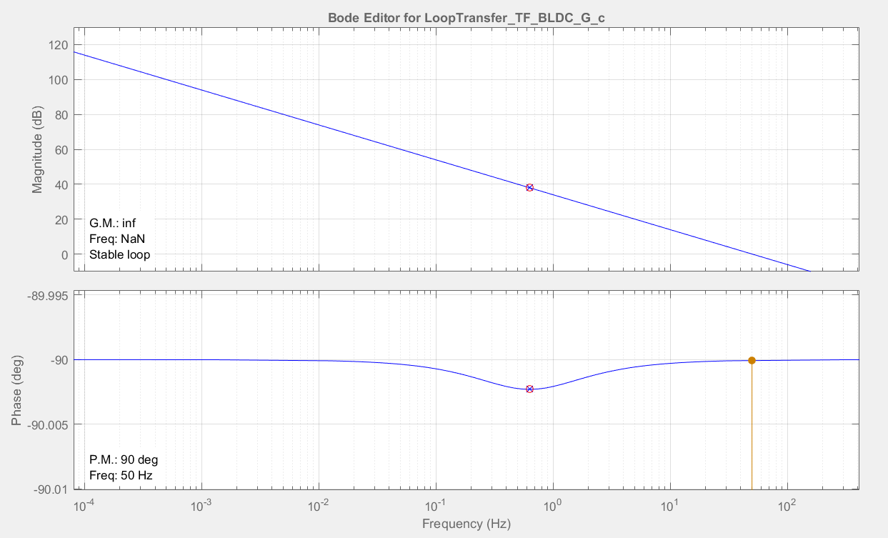

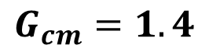
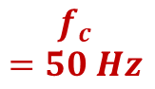
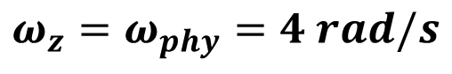
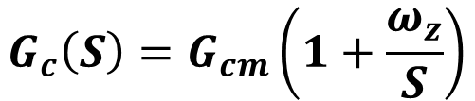

Cont.
PI controller design
$$\left\|T(s)\right\|$$
Is high at low frequency
$$G_{c}\left(S\right)=G_{cm}\left(1+\frac{ω_{z}}{S}\right)$$
$$G_{cm}=1.4$$
$$ω_{z}=ω_{phy}=4 rad/s$$
$φ_{m}=90°$
$$f_{c}$$
$$=50 Hz$$

Slide 17
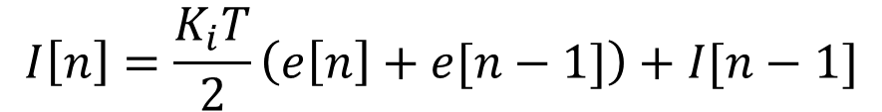
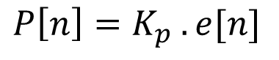
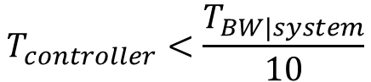
3
Implementation of Discrete PI
Bilinear Discretization of continuous PI controller
$$P\left[n\right]=K_{p} . e[n]$$
$$I\left[n\right]=\frac{K_{i}T}{2}\left(e\left[n\right]+e[n−1]\right)+I[n−1]$$
Practical considerations
Integrator can saturate output
Integrator Anti-windup
Limitations on system inputs
Clamp controller output
Choosing of sampling time
$$T_{controller}<\frac{T_{BW|system}}{10}$$
$$T_{BW|system}=3000 μs → T_{controller}=100 μs$$

Slide 18
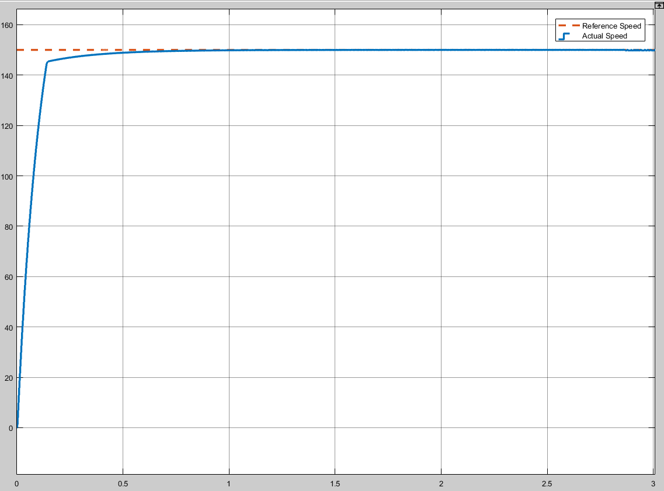
4
Speed Performance
1- Simulink Model

Slide 19
Cont.
Speed Performance
2- Practical Model

Slide 20
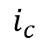
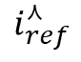
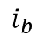
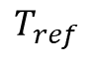
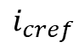
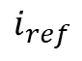
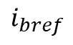
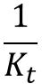
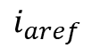
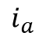
DC Source
Performance Improvement with Hysteresis Current Controller
Inverter
BLDC
Gate pulses
Current controller
Hall Sensors
Reference Current Generator
$$i_{aref}$$
$$i_{a}$$
+
-
Reference Speed
Error
$$T_{ref}$$
$$i_{ref}$$
$$i_{ref}^{⋏}$$
PI controller
$$\frac{1}{K_{t}}$$
Current limiter
$$i_{bref}$$
$$i_{b}$$
+
+
-
-
$$i_{cref}$$
$$i_{c}$$
+
-
Commutation Sequence
Actual Speed
Speed calculation

Slide 21
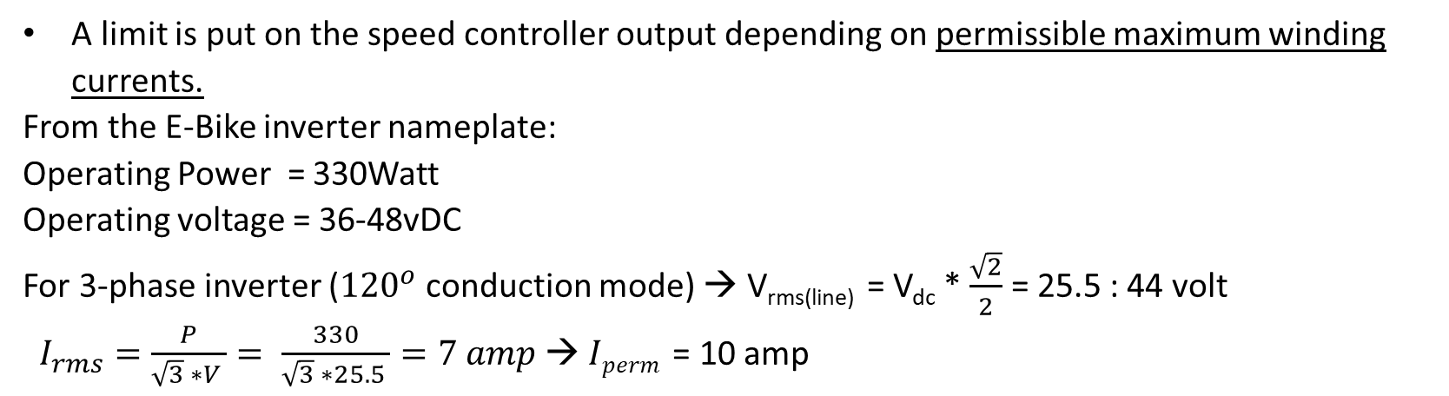
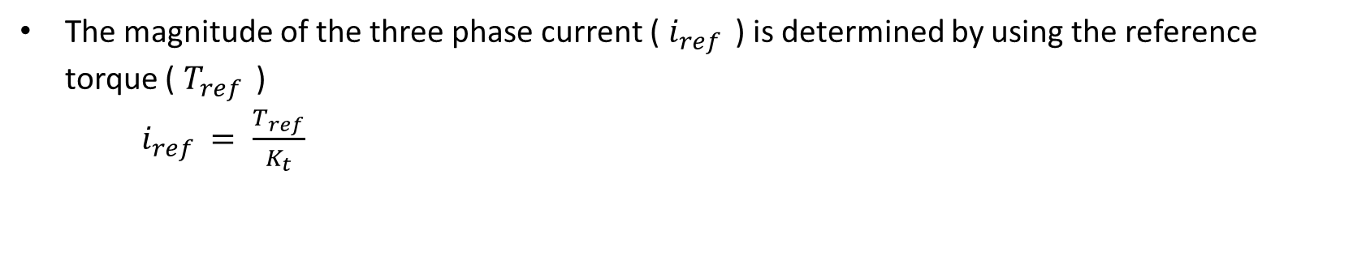
1
Current Limiter
The magnitude of the three phase current ( $i_{ref }$) is determined by using the reference torque ( $T_{ref }$)
$i_{ref }= \frac{T_{ref}}{K_{t}}$
A limit is put on the speed controller output depending on permissible maximum winding currents.
From the E-Bike inverter nameplate:
Operating Power = 330Watt
Operating voltage = 36-48vDC
For 3-phase inverter (${120}^{o}$ conduction mode) → V_{rms(line)} = V_{dc} * $\frac{\sqrt{2}}{2}$ = 25.5 : 44 volt
$I_{rms}=\frac{P}{\sqrt{3} ∗V }= \frac{330}{\sqrt{3} ∗25.5 }=7 amp$ → $Iperm$= 10 amp

Slide 22



2
Reference current generator
If the waveforms of the phase back EMF and phase current are perfectly matched, torque ripple is minimized.
The reference currents for each phase $i_{a}^{∗} ,i_{b}^{∗}$ , $i_{c}^{∗}$ are function of the value of reference current magnitude $i_{ref }$and the rotor position.
Sector | Rotor position | Active switches | $$i_{a}^{∗}$$ | $$i_{b}^{∗}$$ | $$i_{c}^{∗}$$
1 | 0 - 60 | S1 , S6 | $$i_{ref }$$ | - $i_{ref }$ | 0
2 | 60 - 120 | S1 , S2 | $$i_{ref }$$ | 0 | - $i_{ref }$
3 | 120 - 180 | S3 , S2 | 0 | $$i_{ref }$$ | - $i_{ref }$
4 | 180 - 240 | S3 , S4 | - $i_{ref }$ | $$i_{ref }$$ | 0
5 | 240 - 300 | S5 , S4 | - $i_{ref }$ | 0 | $$i_{ref }$$
6 | 300 - 360 | S5 , S6 | 0 | - $i_{ref }$ | $$i_{ref }$$
Reference current w.r.t rotor positions look up table

Slide 23


3
Reference current generator in Simulink

Slide 24


Cont.
Reference current generator in Simulink
Back Emf ‘s and currents
Ia_ref formation

Slide 25



4
With & Without Hysteresis (Phase Current)
At $T_{L}=5 N.m$ | Without Hys | With Hys
Starting current (A) | $$46.7$$ | $$10$$
Current ripples (A) | $$±0.5$$ | $$±1.9$$

Slide 26


Cont.
With & Without Hysteresis (Torque)
At $T_{L}=5 N.m$ | Without Hys | With Hys
Starting Torque (N.m) | $$41.5$$ | $$9$$
Torque ripples (N.m) | $$±1.6$$ | $$±0.4$$

Slide 27


Cont.
With & Without Hysteresis (Speed)
At $T_{L}=5 N.m$ | Without Hys | With Hys
Settling time (sec) | $$0.281$$ | $$1$$

Slide 28

5
Speed Performance at different loads
The motor dynamic behavior is analyzed when different load torques is applied at time t = 2s for the same speed (150 rpm), the initial torque (1 N.m)
C1
C2
C3
Curve | Load torque (N.m) | Speed fall%
C1 | 2 | 2.7
C2 | 3.5 | 6
C3 | 5 | 9.3

Slide 29

6
Speed Performance at reference speeds
The motor dynamic behavior is analyzed when same load torque (1N.m) is applied.
C3
C2
C1
Curve | Speed (rpm) | Settling time (sec)
C1 | 50 | 0.75
C2 | 100 | 0.8
C3 | 150 | 0.9

Slide 30

Braking
Braking is nothing but stopping the machine at a desired position
Braking systems types
Electric braking
Mechanical braking
Dynamic
Plugging
Regenerative

Slide 31
1
Dynamic braking methods
Single switch
Three switch
Lower switches S2, S4, S6 is operated in pulse width modulation (PWM) switching mode at each commutation state
three switches S2, S4, S6 are operated in PWM switching mode at the same time in each commutation state
Two switch
Plugging
two switches out of switches S1-S6 are operated in PWM switching mode at each commutation state
three switches S2, S4, S6 are operated in PWM switching mode at the same time in each commutation state

Slide 32

2
Simulink Model

Slide 33
3
Simulation Results
Single switch
Three switch
Duty | Stopping time (sec) | Braking torque (N.M)
0.1 | 2.382 | -1
0.3 | 2.097 | -2.2
0.5 | 1.744 | -4
0.7 | 1.214 | -7
0.9 | 0.625 | -17.6
Duty | Stopping time (sec) | Braking torque (N.M)
0.1 | 2.364 | -1.25
0.3 | 2.116 | -2.32
0.5 | 1.655 | -4.13
0.7 | 1.164 | -7.3
0.9 | 0.588 | -18.35
Two switch
Plugging
Duty | Stopping time | Braking torque
0.1 | 2.215 | -1.2
0.3 | 1.355 | -2.3
0.5 | 0.48684 | -24.7
0.7 | 0.41648 | -33
0.9 | 0.421 | -38.1
Duty | Stopping time | Braking torque
0.1 | 0.427 | -41
0.3 | 0.427 | -41
0.5 | 0.427 | -41
0.7 | 0.427 | -41
0.9 | 0.427 | -41

Slide 34


Cont.
Simulation Results

Slide 35

IOT

Slide 36

Cont.
IOT
Hardware Connection

Slide 37


Cont.
IOT
Data Exchange
Mobile app

Slide 38
Cont.
IOT
Testing

Slide 39
THANK
YOU!

